Slide 1
Matrix – Test Part

Slide 2
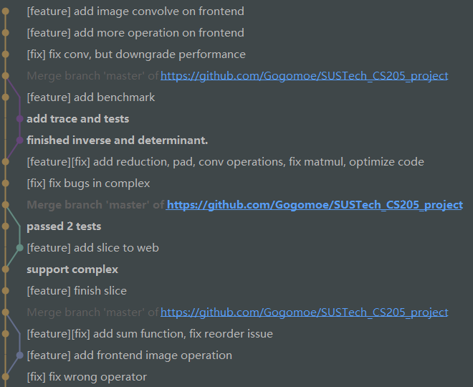
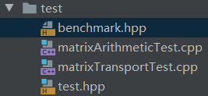
Group Development
We use Git as version control.
During Development, the tests
are required.

Slide 3
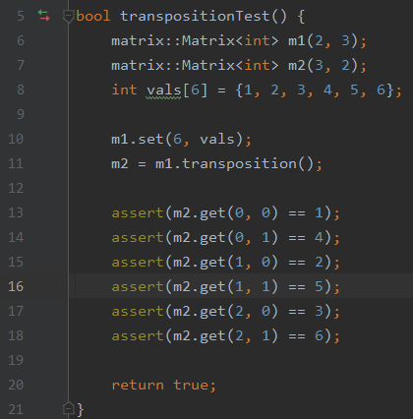
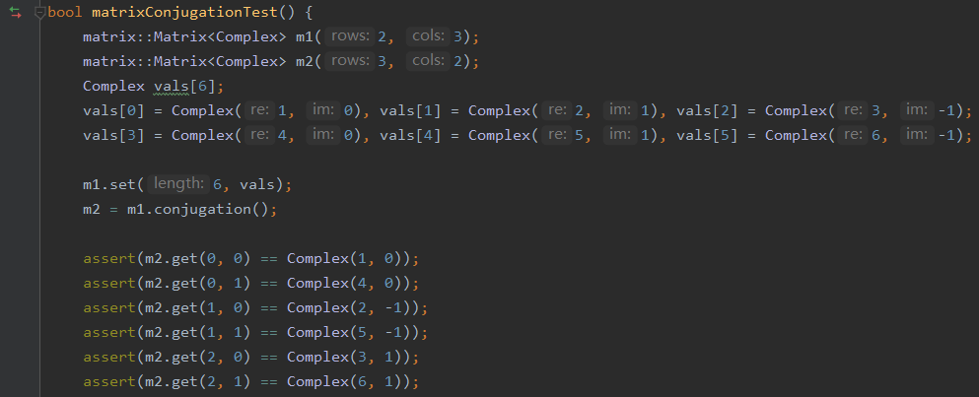
Test Part
For example, to check the function’s realization.

Slide 4
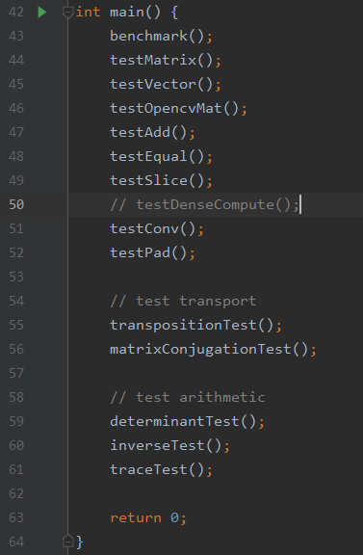
Test Part
All the tests should be done before push operation.

Slide 5
Future Work
The future work may consist 2 parts:
1. Multiple host adoption.
We use Vue.js, which is easy to expand to multiple hosts.
Now we finished web part.
In future wechat app, android, CLI program, everything is possible.
2. Distributed platform optimization.
The current optimization is fast, and can still step one more.
Use MapReduce or MPI to expand to distributed system.
Divide the tasks from different users into different “clients”.

